Slide 1
Genetic Analyses
Ecological Data Analysis
Fall 2020
NSC 133
https://susqu.zoom.us/s/99564587707
MW 8:40-9:25 am

Slide 2
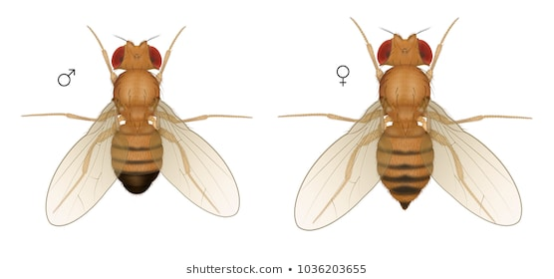
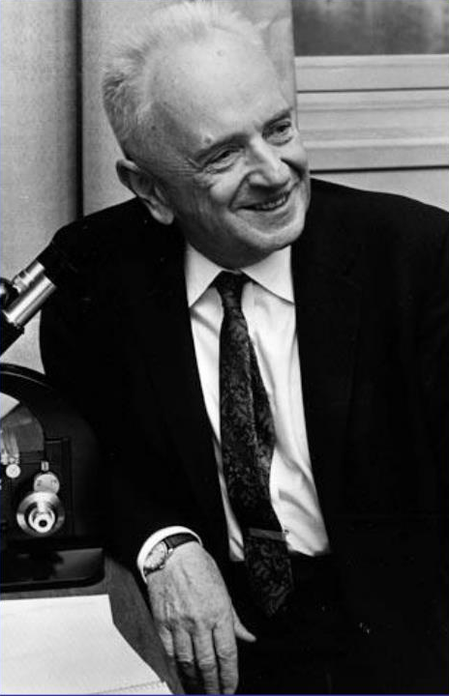

Modern Synthesis
Genetic variation lab -> field
Needed quantitative methods
Natural selection -> present conditions
Biostatistics for genetics
~105 years old
Eugenics = bad
…plus Lysenkoism and other evil uses of data
Dobzhansky = good
Notes:
https://image.shutterstock.com/image-illustration/drosophila-fruit-fly-insect-male-260nw-1036203655.jpg
https://image1.slideserve.com/2727742/slide1-l.jpg

Slide 3
Questions
How are individuals/species related?
How do mutations and diversity impact adaptation?
How well do they adapt to environmental changes?
Over what time scale?
How do genotypes -> phenotypes?
How does genetic diversity relate to species resistance, resilience, and stability?
Started with relating populations and species.

Slide 4
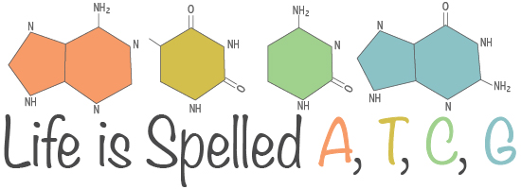
The data
A, T, C, G
Clearly defined possibilities
Clearly defined rates of change
Clearly defined translation to function
Sometimes
The level of organization vs scale of question
AKA when are too many data a problem?
DNA -> Alleles -> haplotypes
The biological aggregate() function
The environment (abiotic + biotic)
Notes:
https://askananthropologist.asu.edu/sites/default/files/headers/dna_and_taxonomy_subheader.jpg

Slide 5
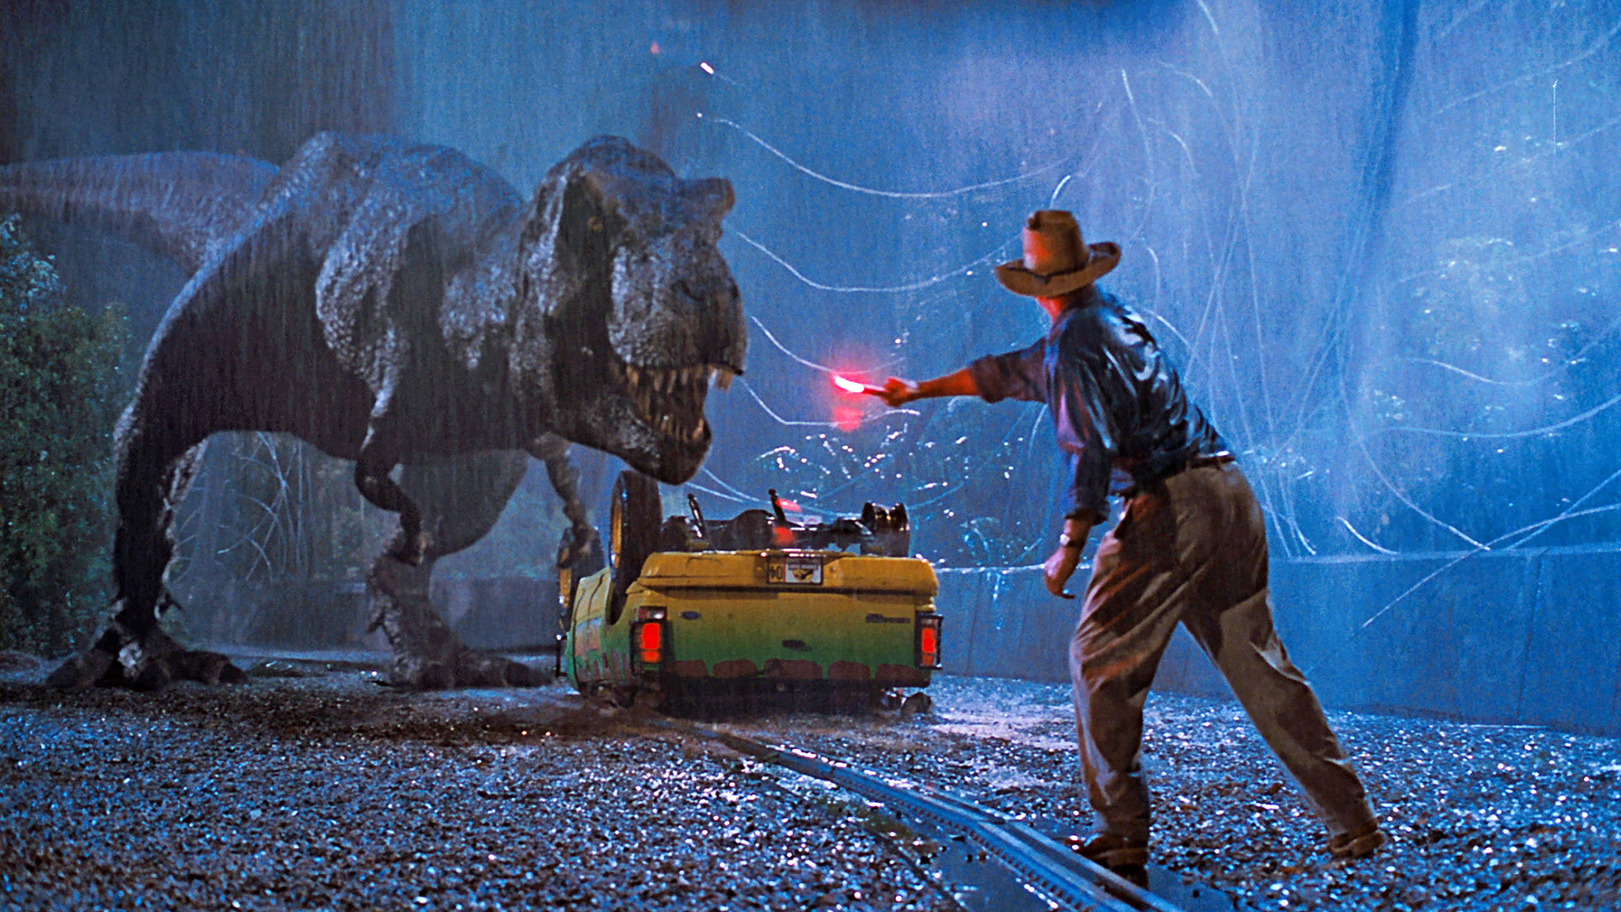
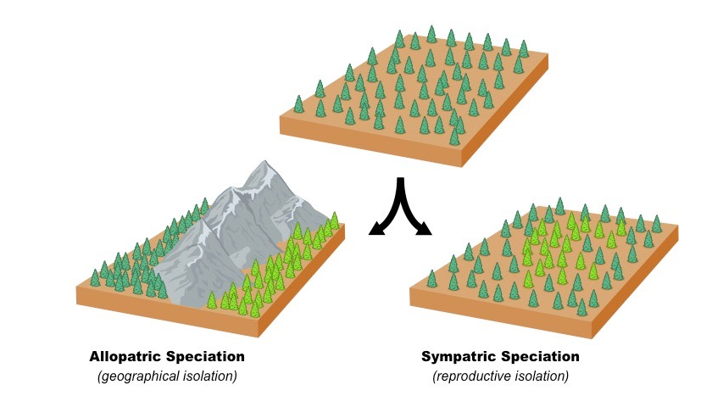
How do we relate DNA to ecology?
Space + Time
Or space FOR time
Landscape + isolation
Rates of change
Stress
Habitats + environment
Intra + interspecific interactions
Species detection/abundance
Community ecology – stay tuned
Notes:
https://vivadifferences.com/wp-content/uploads/2019/10/Allopatric-Vs-Sympatric-Specia
https://static01.nyt.com/images/2018/06/12/arts/television/12jurassic-park-watching/jurassic-park-watching-superJumbo-v2.jpgtion.png

Slide 6
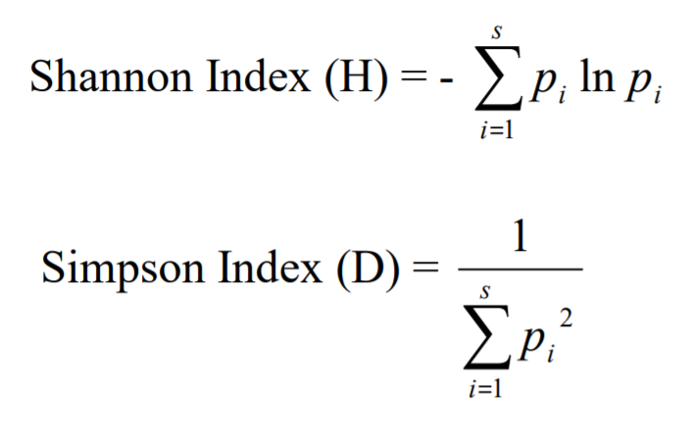
The Stats
Genetic diversity + richness
Shannon and Simpson’s
Made for count data (p = proportion)
Genetic are presence/absence
Evenness (i.e. histograms)
Several methods to calculate
What’s the point?
Community [ or genetic] stability
Notes:
http://entnemdept.ufl.edu/hodges/ProtectUs/lp_webfolder/9_12_grade/Student_Handout_1A.pdf

Slide 7
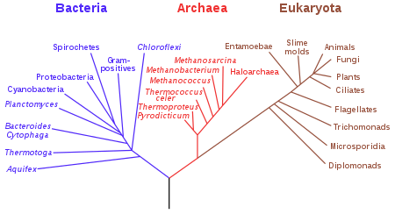
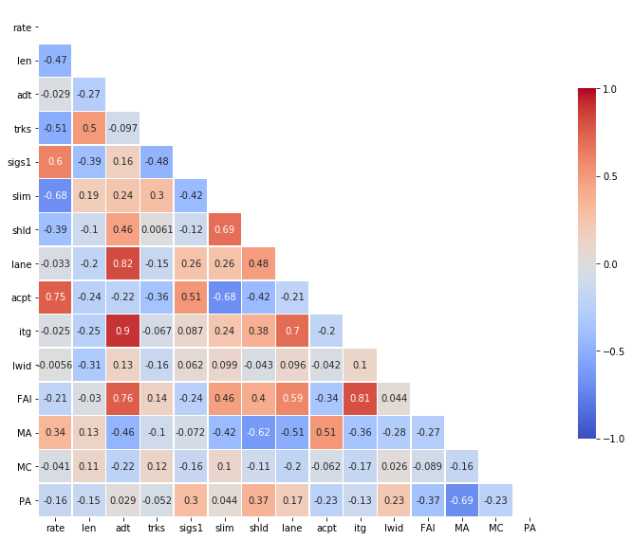
Phylogenetics
Relationships between:
Individuals
Populations
Species
Maximum parsimony this week
Distance or correlation matrix
community methods for similarity
Bayesian statistics
Computationally intensive
Pass for now
Notes:
https://upload.wikimedia.org/wikipedia/commons/thumb/7/70/Phylogenetic_tree.svg/450px-Phylogenetic_tree.svg.png
https://www.kdnuggets.com/wp-content/uploads/heatmap.png

Slide 8
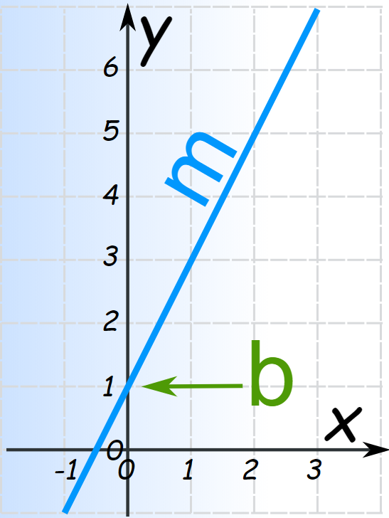
Environmental relationships
Linear models
y ~ x + ε
Building to include multiple predictors
y ~ x₁ +x₂ +x₃… + ε
P value vs R squared vs slope
Single factor regression (R-bloggers)
Over-fitting data?
Reality?
Often non-linear interactions
Notes:
https://www.mathsisfun.com/algebra/images/y-mxpb-graph.svg

Slide 9
Space and Dryad data

